Slide 1
Oscillator

Slide 2
An oscillator is an electronic circuit that gives an output without any input signal.
It comprises active and passive circuit elements and sinusoidal produces repetitive waveforms at the output without the application of a direct external input signal to the circuit.
It converts the dc power from the source to ac power in the load. A rectifier circuit converts ac to dc power, but an oscillator converts dc noise signal/power to its ac equivalent.
The general form of a harmonic oscillator is an electronic amplifier with the output attached to a narrow-band electronic filter and the output of the filter attached to the input of the amplifier.

Slide 3

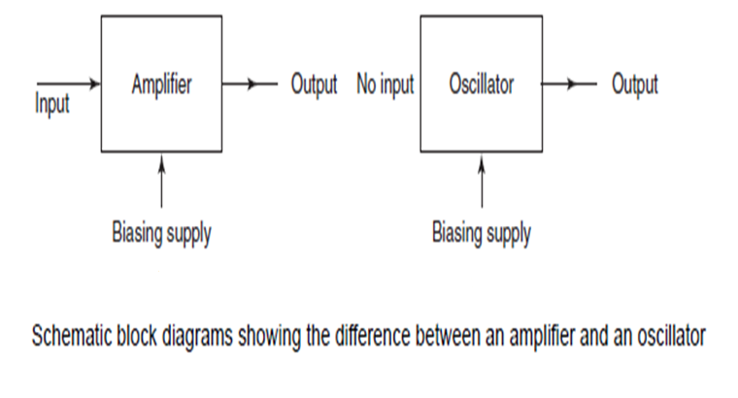

Slide 4

Oscillators are classified based on the type of the output waveform.
If the generated waveform is sinusoidal or close to sinusoidal (with a certain frequency) then the oscillator is said to be a Sinusoidal Oscillator.
If the output waveform is non-sinusoidal, which refers to square/saw-tooth waveforms, the oscillator is said to be a Relaxation Oscillator.
An oscillator has a positive feedback with the loop gain infinite.

Slide 5
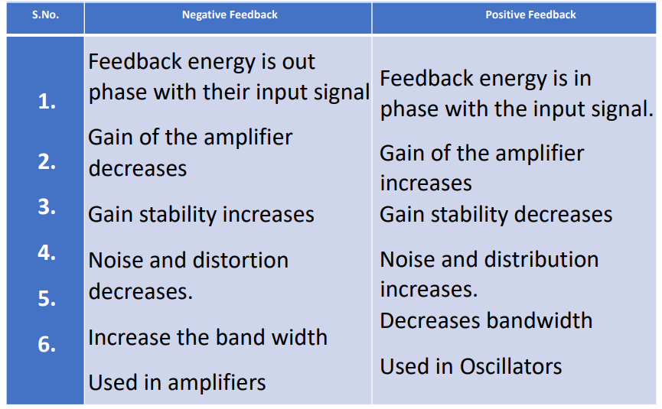


Slide 6

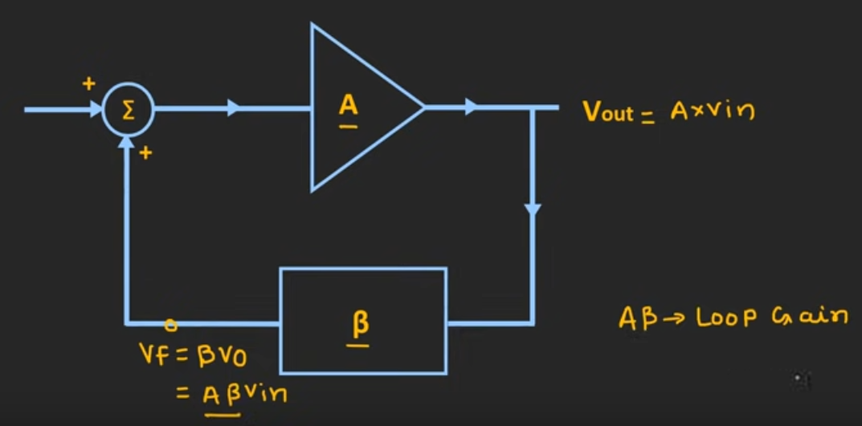

Slide 7

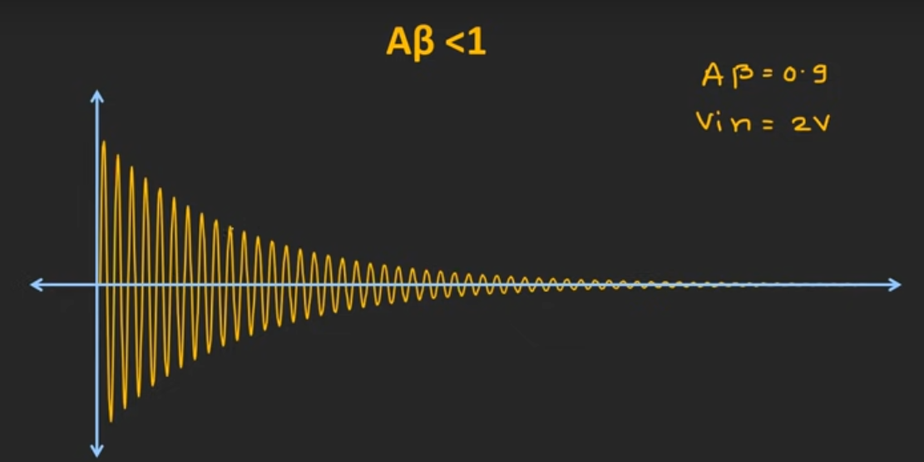

Slide 8
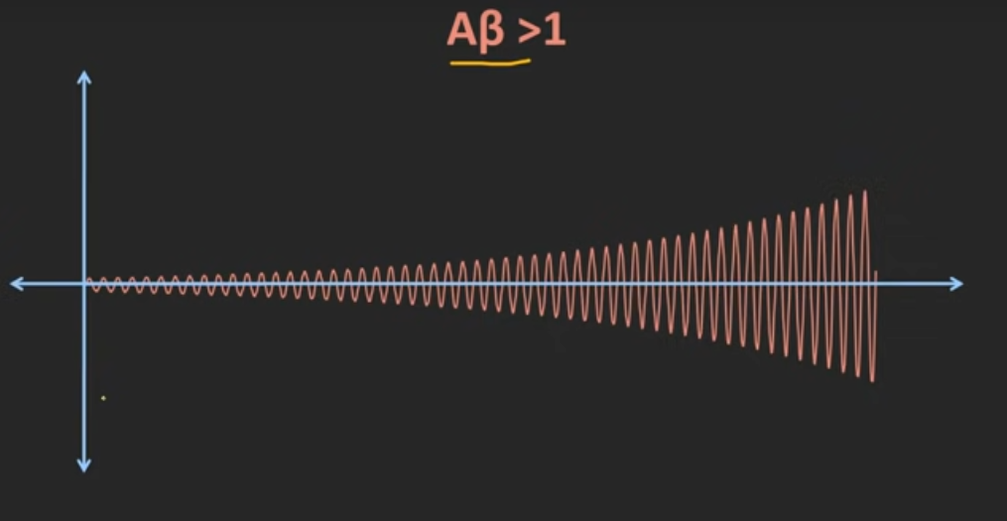

Slide 9
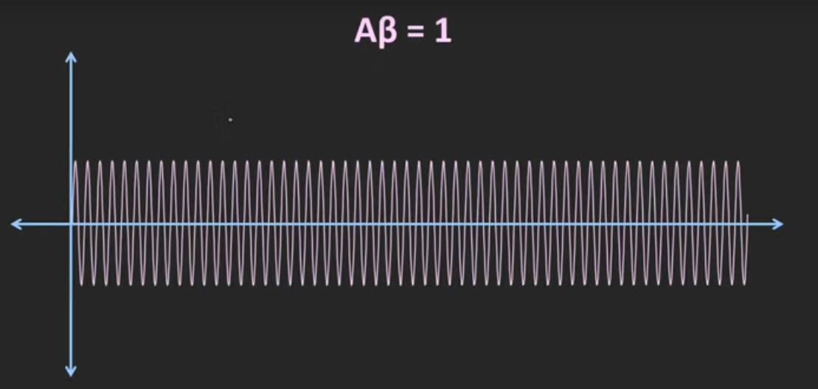

Slide 10

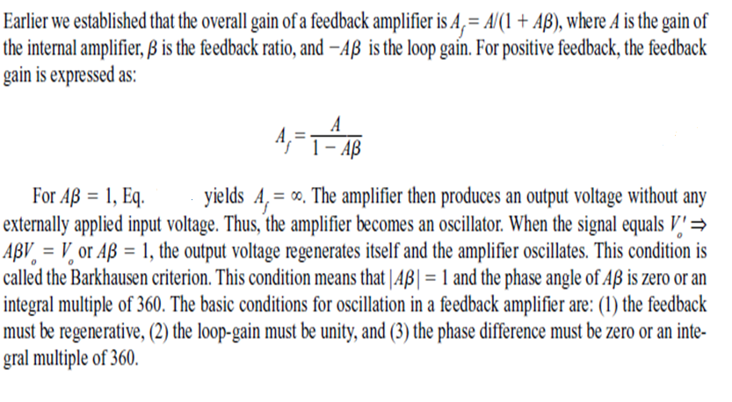

Slide 11

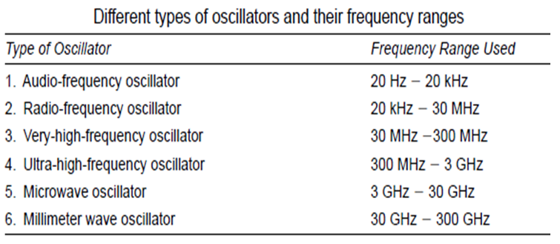
The classification of various oscillators is shown in the table

Slide 12
Oscillators are a common element of almost all electronic circuits. They are used in various applications, and their use makes it possible for circuits and subsystems to perform numerous useful functions.
In oscillator circuits, oscillation usually builds up from zero when power is first applied under linear circuit operation.
The oscillator’s amplitude is kept from building up by limiting the amplifier saturation and various non-linear effects.
Oscillator design and simulation is a complicated process. It is also extremely important and crucial to design a good and stable oscillator.
Oscillators are commonly used in communication circuits. All the communication circuits for different modulation techniques—AM, FM, PM—the use of an oscillator is must.
Oscillators are used as stable frequency sources in a variety of electronic applications. (Quartz watches)
Oscillator circuits are used in computer peripherals, counters, timers, calculators, phase-locked loops, digital multi-metres, oscilloscopes, and numerous other applications.

Slide 13
Crystal oscillator is most commonly used oscillator with high-frequency stability. They are used for laboratory experiments, communication circuits and biomedical instruments. They are usually fixed frequency oscillators where stability and accuracy are the primary considerations.
In order to design a stable and accurate LC oscillator for the upper HF and higher frequencies it is absolutely necessary to have a crystal control; hence, the reason for crystal oscillators.
Crystal oscillators are oscillators where the primary frequency determining element is a quartz crystal. Because of the inherent characteristics of the quartz crystal the crystal oscillator may be held to extreme accuracy of frequency stability. Temperature
compensation may be applied to crystal oscillators to improve thermal stability of the crystal oscillator.
The crystal size and cut determine the values of L, C, R and C'. The resistance R is the friction of the vibrating crystal, capacitance C is the compliance, and inductance L is the equivalent mass. The capacitance C' is the electrostatic capacitance between the mounted pair of electrodes with the crystal as the dielectric.

Slide 14

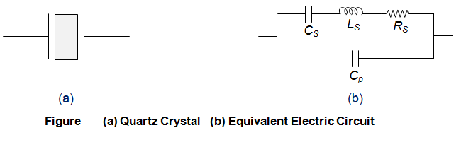

Slide 15
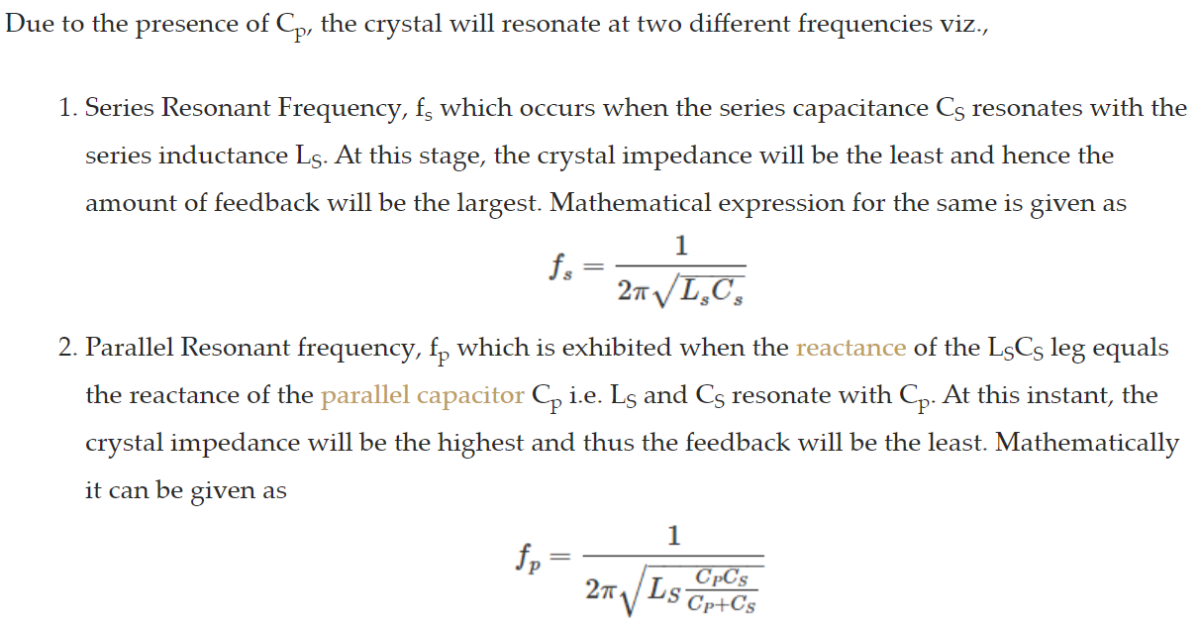
Reactance: the part of the impedance of an alternating-current circuit that is due to capacitance or inductance or both and that is expressed in ohms.

Slide 16

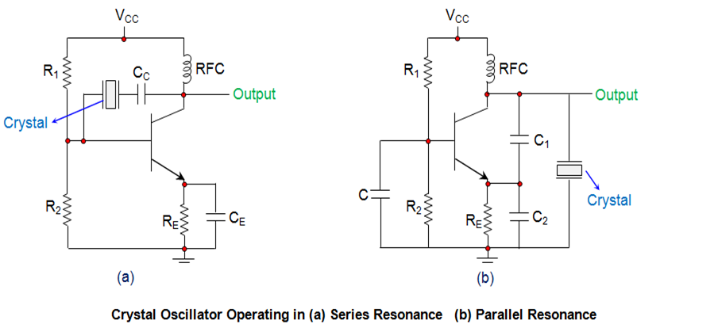

Slide 17

In the circuits shown, the resistors R₁ and R₂ form the voltage divider network while the emitter resistor R_{E} stabilizes the circuit. Further, C_{E} acts as an AC bypass capacitor while the coupling capacitor C_{C} is used to block DC signal propagation between the collector and the base terminals.
Next, the capacitors C₁ and C₂ form the capacitive voltage divider network . In addition, there is also a Radio Frequency Coil (RFC) in the circuits which offers dual advantage as it provides even the DC bias as well as frees the circuit-output from being affected by the AC signal .
On supplying the power to the oscillator, the amplitude of the oscillations in the circuit increases until a point is reached wherein the nonlinearities in the amplifier reduce the loop gain to unity. Next, on reaching the steady-state, the crystal in the feedback loop highly influences the frequency of the operating circuit. Further, here, the frequency will self-adjust so as to facilitate the crystal to present a reactance to the circuit such that the Barkhausen phase requirement is fulfilled.
The typical operating range of the crystal oscillators is from 40 KHz to 100 MHz

Slide 18
Advantages of Crystal Oscillator:
The crystal oscillator has very low frequency drift due to change in temperature and other parameters.
The crystal oscillator Q is very high.
It has Automatic amplitude control.
It has very high frequency stability.
The crystal oscillator is possible to obtain very high precise and stable frequency of oscillators.

Slide 19
Disadvantages of crystal oscillator:
Crystals of low fundamental frequencies are not easily available.
These are suitable for high frequency application.
Applications of crystal oscillator:
The crystal oscillators are used in radio and TV transmitters.
It is used as a crystal clock in microprocessors.
It is used in the frequency synthesizers.
It is used in special types of receivers.

